Slide 1

Safeguarding Children's Spaces with AI Vision
An intelligent computer vision system designed to detect hazardous objects in children's environments before accidents happen, providing peace of mind for parents and carers.
גונקו דניאל 340969674
גבריס סבטלנה 342794732
סמיון אוסטרובסקי 342795754

Slide 2

The Challenge
Hidden Dangers in Safe Spaces
Parents and childminders face a constant challenge: identifying dangerous objects in children's rooms before they cause harm. Even in seemingly safe environments, small items, sharp objects, chemical bottles, or damaged cables can hide behind toys or lie on the floor.
These hidden hazards can lead to choking, injuries, or exposure to dangerous substances—often without warning.

Slide 3
Why Traditional Data Collection Fails
Privacy Concerns
Ethical Barriers
Rare Occurrences
Collecting real images from homes raises serious privacy issues for families.
Deliberately exposing children to dangerous situations for photography is unacceptable.
Most hazardous situations are infrequent and difficult to document authentically.
These limitations make synthetic data generation through GenAI models essential for creating a robust, safe, and privacy-preserving training dataset.

Slide 4



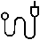
Four Critical Danger Categories
Choking Hazards
Sharp Objects
Small objects that could obstruct airways
Items that could cause cuts or puncture wounds
Chemical Dangers
Electrical Hazards
Cleaning products, detergents, or any chemical bottles that could be ingested or cause harm.
Exposed cables, torn adapters, damaged sockets—simulated safely for training purposes only.

Slide 5

Innovation Through Synthetic Data
No existing open dataset focuses specifically on hazardous objects in children's rooms.

Slide 6
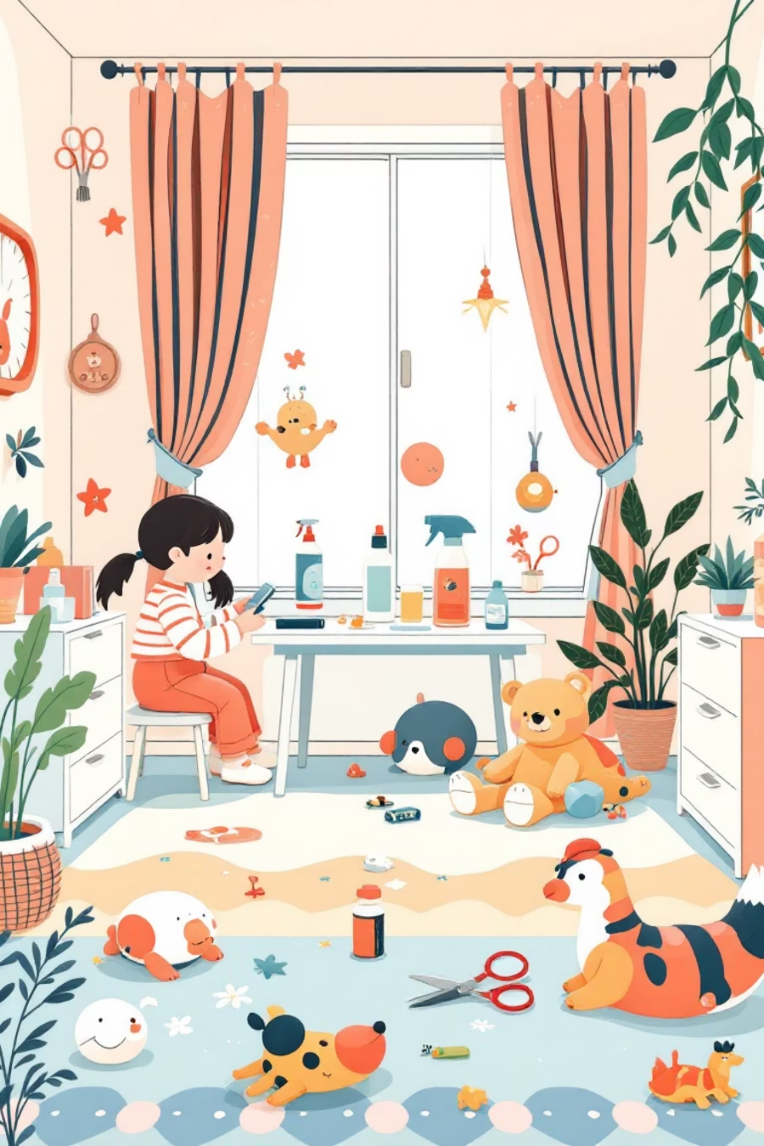
The ML Task: Object Detection for Safety
Input
Example Detection
Picture of a children's room
Battery on carpet → Bounding box + "Small choking hazard"
Output
Scissors on table edge → Bounding box + "Sharp object"
Bounding boxes around detected objects
Category labels from 4 danger types
Cleaning bottle near toys → Bounding box + "Chemical hazard"
Optional risk severity rating (low/medium/high)

Slide 7





Spotting the Hidden Dangers
Even in seemingly safe environments, small objects and everyday items can pose significant risks to young children. Our system is designed to identify these subtle threats.
This image demonstrates how hazards like scissors or small batteries can easily go unnoticed in a typical child's room, highlighting the need for an intelligent detection system.

Slide 8

Synthetic Data Generation Strategy
We employ advanced generative models including Stable Diffusion, ControlNet, and Inpainting techniques to create diverse children's room scenarios.
Controlled Variables
Multiple camera angles
Varied lighting conditions
Different clutter levels (tidy vs. toy-filled rooms)
Partial object occlusion (items behind toys, under furniture)
Negative examples (safe rooms without hazards for balanced training)

Slide 9



Model Selection & Experimental Design
YOLOv8/v10
DETR/ViT-Det
SAM (Optional)
Fast, powerful real-time object detection models optimised for speed and accuracy.
Transformer-based architectures providing alternative detection approaches for comparison.
Segment Anything Model for enhanced boundary refinement in later development stages.

Slide 10
Success Metrics
mAP
IoU
F1
Mean Average Precision
Intersection over Union
F1 Score
By combining cutting-edge computer vision with synthetic data generation, this system promises to revolutionise child safety in homes, nurseries, and smart home environments—delivering early warnings that prevent accidents before they occur.

Slide 11
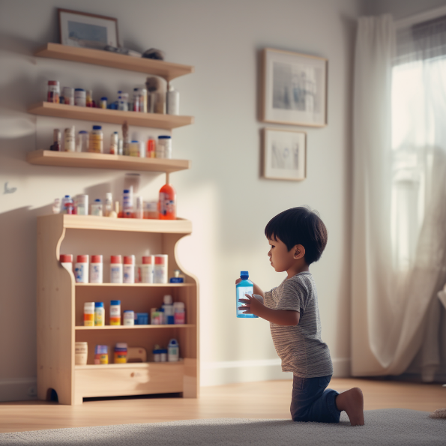
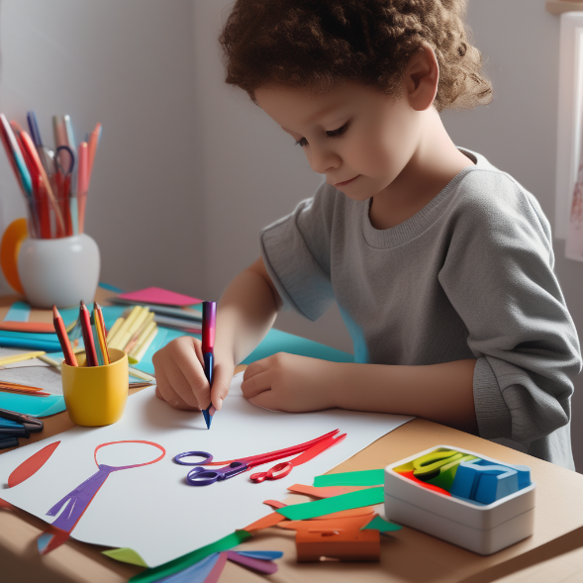
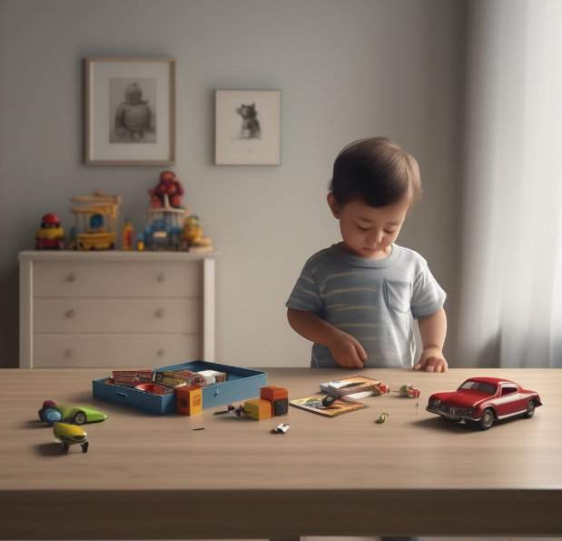
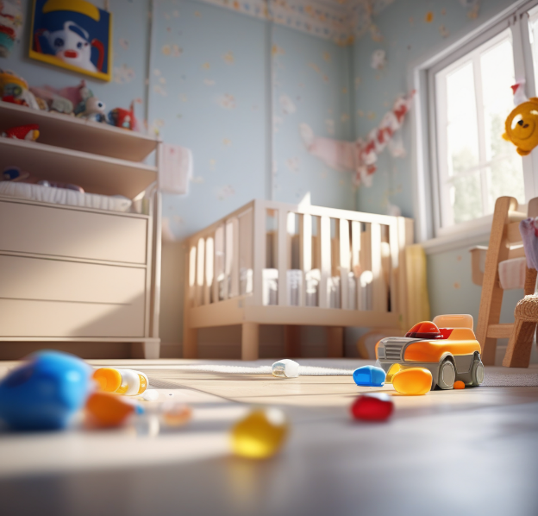
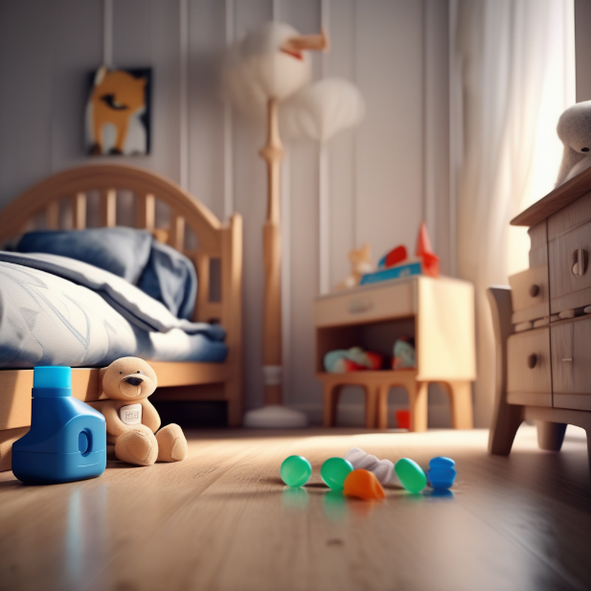
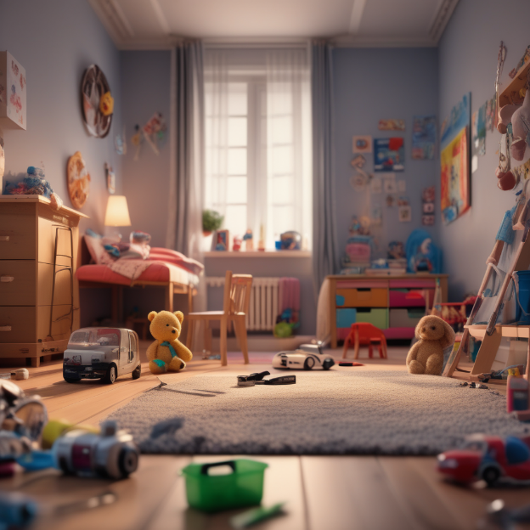
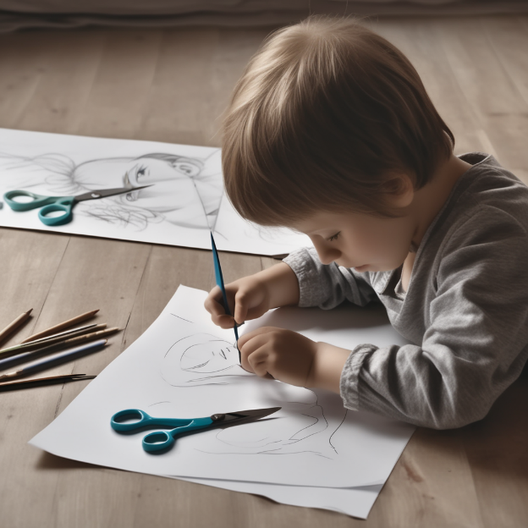
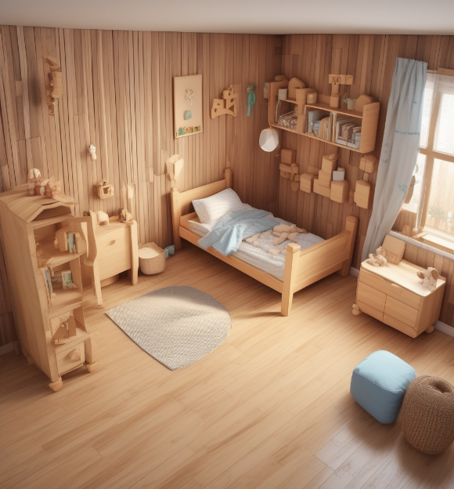
Sample data

Slide 12
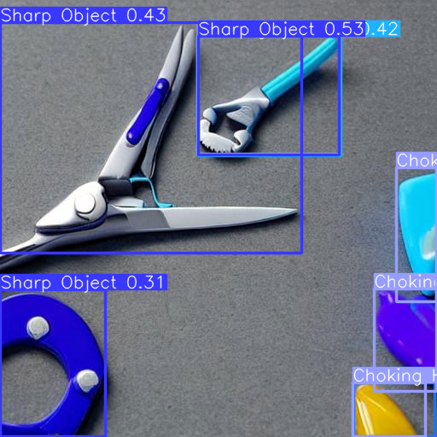
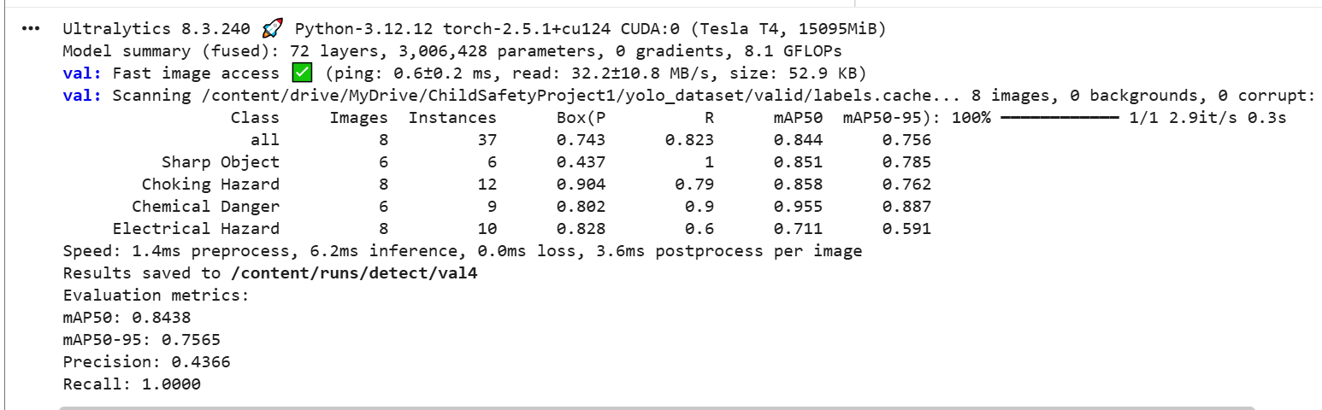
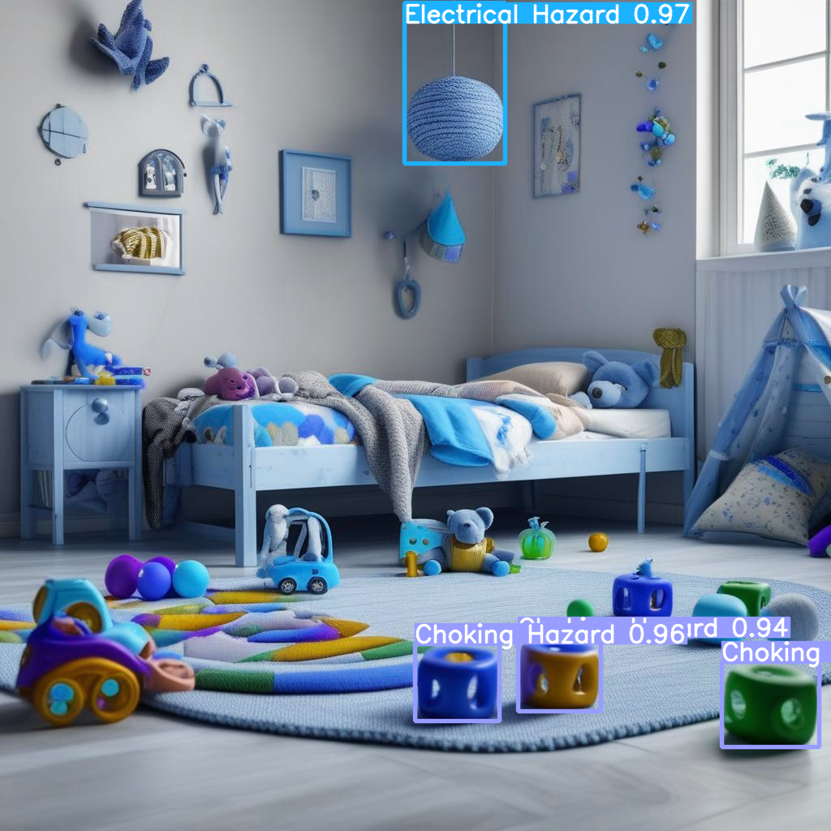
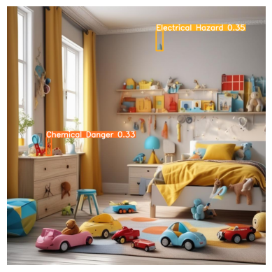
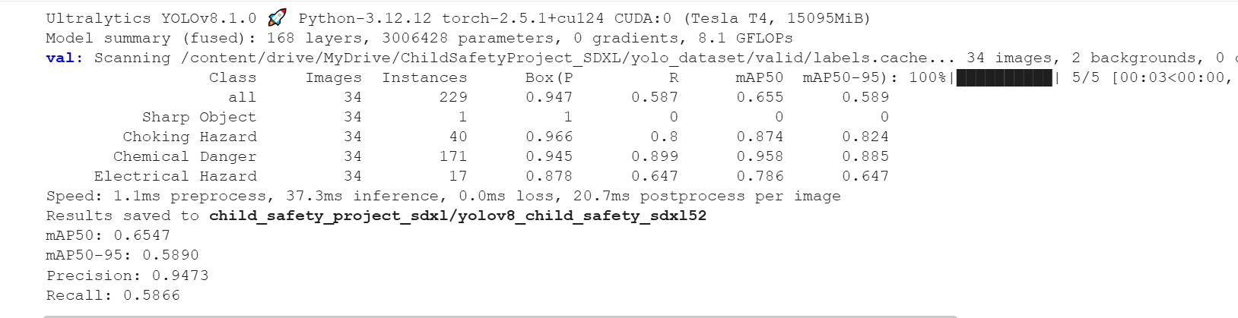
The results of a test models
Model 1
Model 2

